Slide 1
Incorporating User Feedback
Some Memes and GIFs

Slide 2
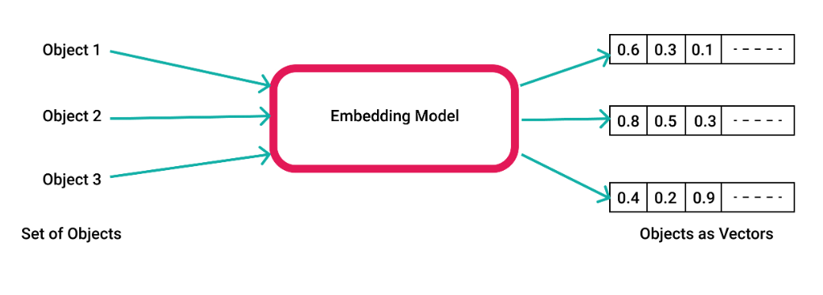

Slide 3
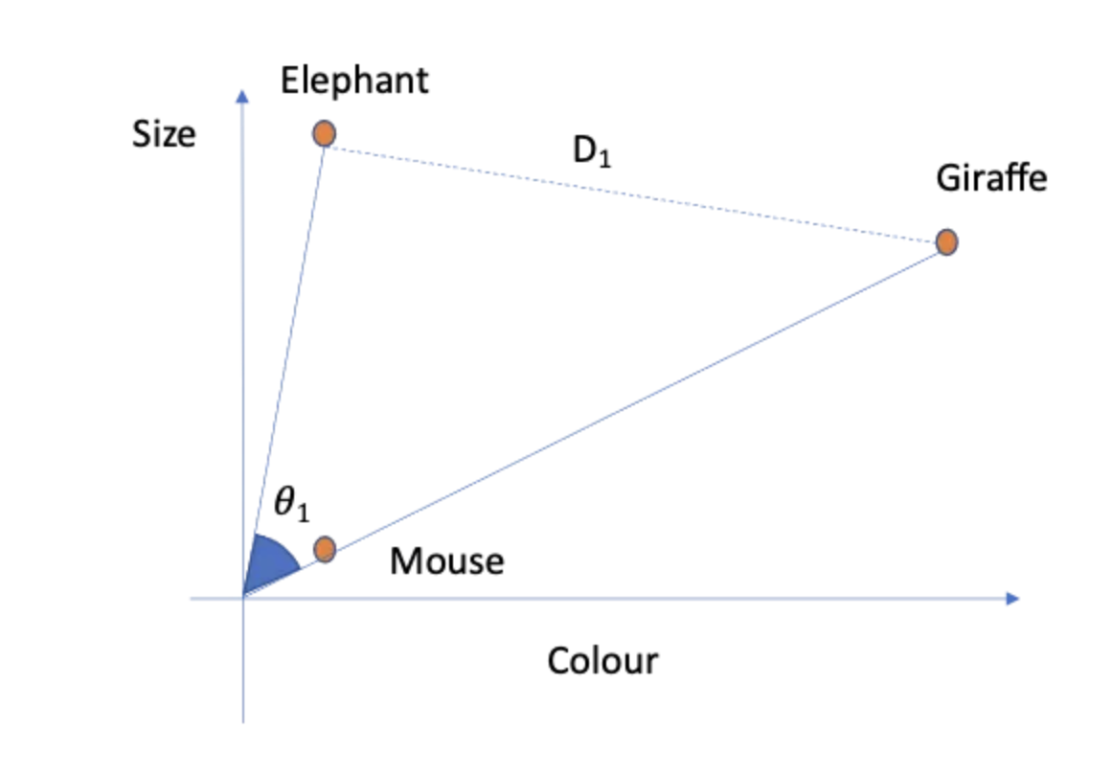

Slide 4
Suggested tech stack
Vector database to store embeddings:
Pinecode
Qdrant
Faiss (used here, maybe not for production)
Relational database
File storage
We generate text files, like changes to the output, etc
Openai models
Langchain
Maybe a cloud provider: azure, aws

Slide 5

Get ready

Slide 6
User’s First Input

Slide 7
User’s First Input
Prompts based on rules
First generated content

Slide 8
User’s First Input
Prompts based on rules
First generated content
Sections
Photo metadata embeddings
Positive Reviews embeddings

Slide 9
User’s First Input
Prompts based on rules
First generated content
Did user change output?

Slide 10
User’s First Input
Prompts based on rules
First generated content
Did user change output?
No
yes

Slide 11
User’s First Input
Prompts based on rules
First generated content
Did user change output?
No

Slide 13
User’s First Input
Prompts based on rules
First generated content
Did user change output?
No
Track revenue
Track reviews

Slide 14
User’s First Input
Prompts based on rules
First generated content
Did user change output?
No
yes

Slide 16
Did user change output?
yes
Store changed output
Count number of changes

Slide 17
Did user change output?
yes
Store changed output
Count number of changes
Analyze differences in generated vs changed versions
Did user add other sources?

Slide 18
Did user change output?
yes
Store changed output
Count number of changes
Analyze differences in generated vs changed versions
Did user add other sources?
No
yes

Slide 19
Did user change output?
yes
Store changed output
Count number of changes
Analyze differences in generated vs changed versions
Update second generated prompt

Slide 20
Did user change output?
yes
Store changed output
Count number of changes
Analyze differences in generated vs changed versions
Update second generated prompt
Create topics from changes
Track revenue changes
Track review changes

Slide 21
Did user change output?
yes
Store changed output
Count number of changes
Analyze differences in generated vs changed versions
Update second generated prompt

Slide 22
Did user change output?
yes
Store changed output
Count number of changes
Analyze differences in generated vs changed versions
Update second generated prompt

Slide 23
Did user change output?
yes
Store changed output
Count number of changes
Analyze differences in generated vs changed versions
Update third generated prompt

Slide 24
Did user change output?
yes
Store changed output
Count number of changes
Analyze differences in generated vs changed versions
Update third generated prompt

Slide 25
Did user change output?
yes
Store changed output
Count number of changes
Analyze differences in generated vs changed versions
Update third generated prompt
Max changes reached?

Slide 26
Did user change output?
yes
Store changed output
Count number of changes
Analyze differences in generated vs changed versions
Update third generated prompt
Max changes reached?

Slide 27
Update third generated prompt
Max changes reached?
No
yes

Slide 28
Update third generated prompt
Max changes reached?
No
yes

Slide 30
Update third generated prompt
Max changes reached?
No
yes
Continue editing

Slide 31
Update third generated prompt
Max changes reached?
No
yes

Slide 33
Update third generated prompt
Max changes reached?
No
yes
Ask user for more specific feedback

Slide 34
Did user change output?
yes
Store changed output
Count number of changes
Analyze differences in generated vs changed versions
Did user add other sources?
No
yes

Slide 35
Did user add other sources?
No
yes
Embed and analyze sources

Slide 36
Did user add other sources?
No
yes
Embed and analyze sources
Do checks
Cosine similarity vs generated content
Cosine similarity vs reviews
Cosine similarity vs similar properties

Slide 37
Do checks
Cosine similarity vs generated content
Cosine similarity vs reviews
Cosine similarity vs similar properties
Does external source help?

Slide 38
Do checks
Cosine similarity vs generated content
Cosine similarity vs reviews
Cosine similarity vs similar properties
Does external source help?
No
yes

Slide 39
Do checks
Cosine similarity vs generated content
Cosine similarity vs reviews
Cosine similarity vs similar properties
Does external source help?
No
yes

Slide 41
Does external source help?
No
yes
Inform user that external source does not add value
Discard and continue

Slide 42
Do checks
Cosine similarity vs generated content
Cosine similarity vs reviews
Cosine similarity vs similar properties
Does external source help?
No
yes

Slide 44
Does external source help?
No
yes
Update next prompt

